Slide 1
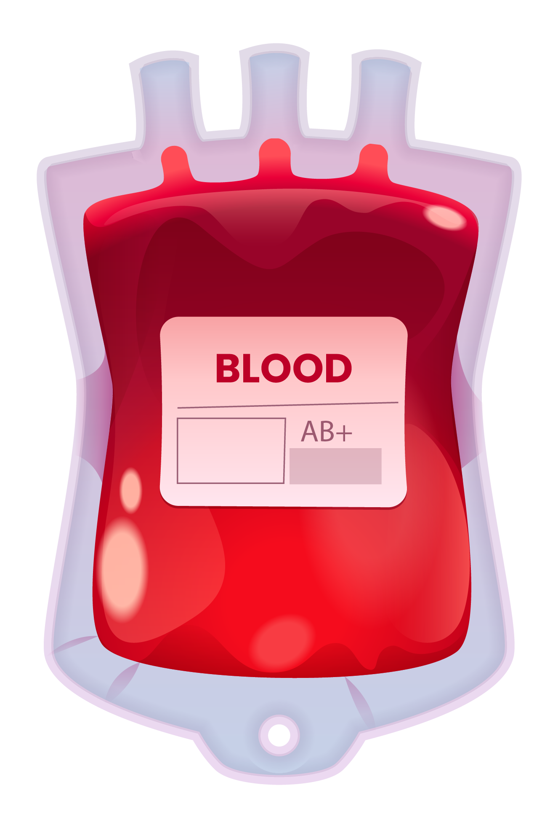
BLOOD BANKING SYSTEM

Slide 2
Roadmap
Introduction
Design Flow
Results
1
3
5
2
4
6
Idea/Approach
Implementation
Team Details
2

Slide 3
INTRODUCTION
Blood, the life-sustaining fluid that passes through our veins, plays an irreplaceable role in maintaining human health and liveliness.
Every day, many individuals face medical emergencies, surgeries, accidents and chronic illnesses that needs blood transfusions. In these critical situations, the availability of safe and compatible blood matters life and death.
The urgent need for blood donation, a selfless act directly impacts the well-being of both donors and recipients.

Slide 4
20,0000
50,000
5,000
This is the number of patients dies over past 2 years
This is the number of patients died in India
This is the number of patients died over past 3 months in India

Slide 5
World Statistics Deaths Rate
USA 15%
India 25%
South Africa 45%

Slide 6
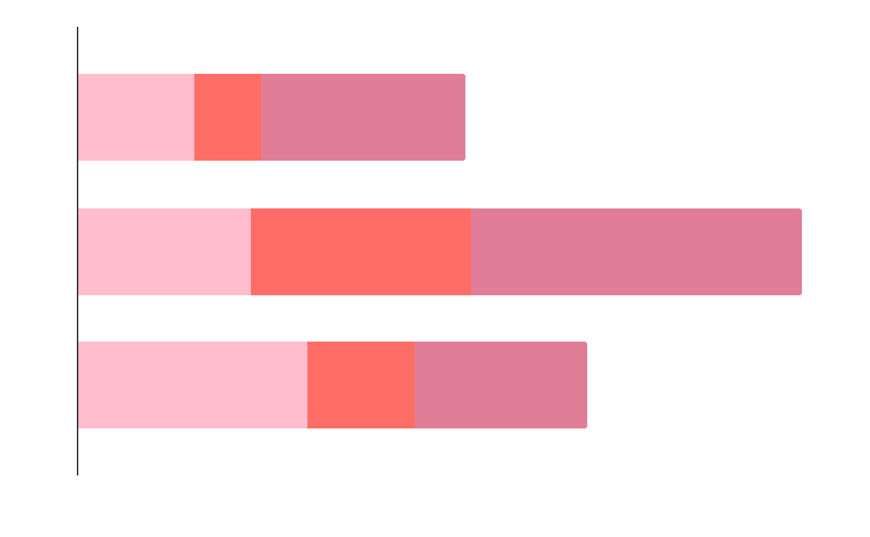
OUR STATISTICS
25%
India
45%
South Africa
15%
USA

Slide 7
BLOOD GROUPS

Slide 8






“You are not important because of how long you live, you are important because of how effective you live.” – Myles Munroe

Slide 9



IDEA /APPROACH
1. Despite of its importance the availability of safe and sufficient blood remains as a challenge in many parts of world due to misconceptions, fears, and reachability.
2. The “Blood Banking System – Reforming Blood Donation and Emergency Blood Requests” presents a comprehensive digital solution designed to reshape the blood donation and emergency blood requests.
3. Integrated with advance technology with healthcare needs, this system offers an usercentric functionalities.
4. With this user-friendly system, people wanting to donate blood can easily sign up, provide important health information, and verify their blood test results with integrated security to maintain user data privacy.

Slide 10

MISSION
In times of crisis, we pledge to be the beacon of hope, offering recipients swift and informed access to potential donors through intuitive search functionalities. With integrated mapping services, we ensure that blood bank centers are just a click away, delivering the life-saving resources where they are needed most.
VISION
Our systematic approach to blood banking not only revolutionizes donation but also encourages the culture of taking and giving back by bridging the gap between donors and recipients. By providing an efficient and user-friendly interface, this project build the way for a future where the act of donating blood and saving lives is made more accessible, engaging and impactful.

Slide 11
DESIGN PROCESS
User Interface
Front End
Business Logic
Back End
Google API
Location Tracking System

Slide 12
Process Hierarchy
Register
Login
Home

Slide 13
Donor
Blood Bank
Register Blood Bank
Delete Blood Bank
Register as donor
Update
Details
Delete
List All Donors
List All Banks

Slide 14
Search Functionalities
Search Near by Location
Search in District
Search by Blood Group

Slide 15
USER REGISTRATION
User Register in the App
Name
Mobile
Email
Medial Details
REGISTER
User Logins after validation

Slide 16


Dash Board
Services
User Services
Donate Blood
Ask for Blood
Check health status
Upload Health reports

Slide 17
Donate Blood
Ask for Blood
Check health status
Upload Health reports
Find Near by Hospital
Near by Blood Bank Centers
Search near by donors by Locations, by Blood Groups
Update Name, Blood group, health details
BP Level
Sugar Level
Donate
See Nearby
Donors
Generate
Upload

Slide 18
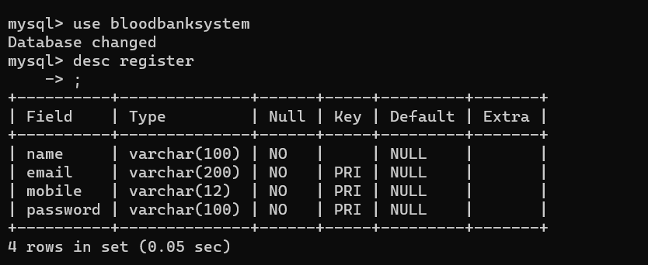
Data Base Schema

Slide 19
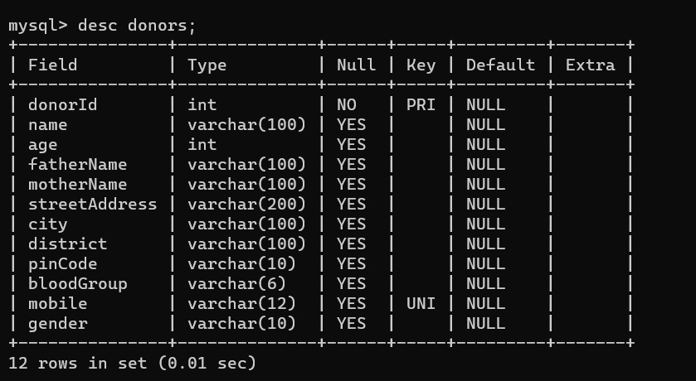

Slide 20
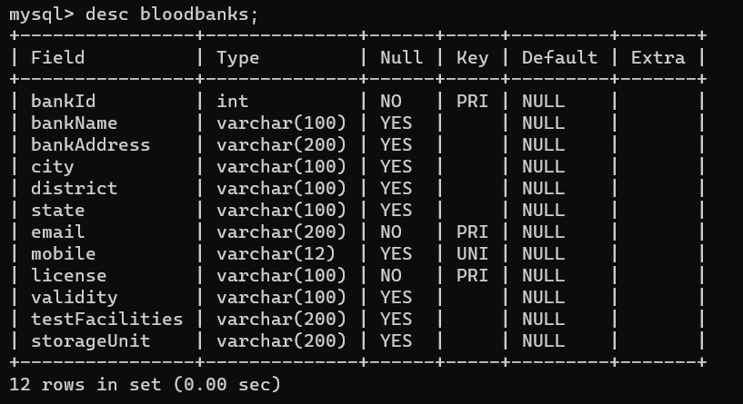

Slide 21
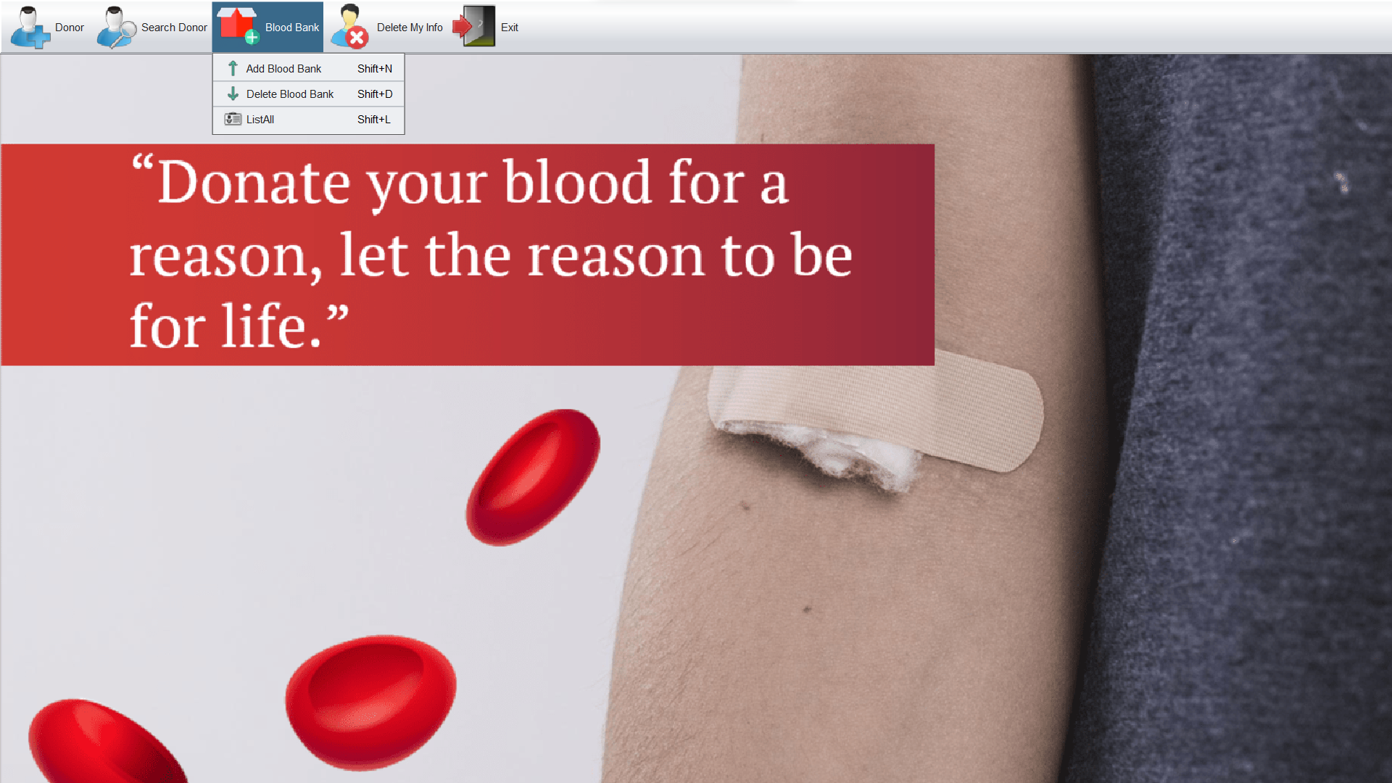
Home Web Page

Slide 22
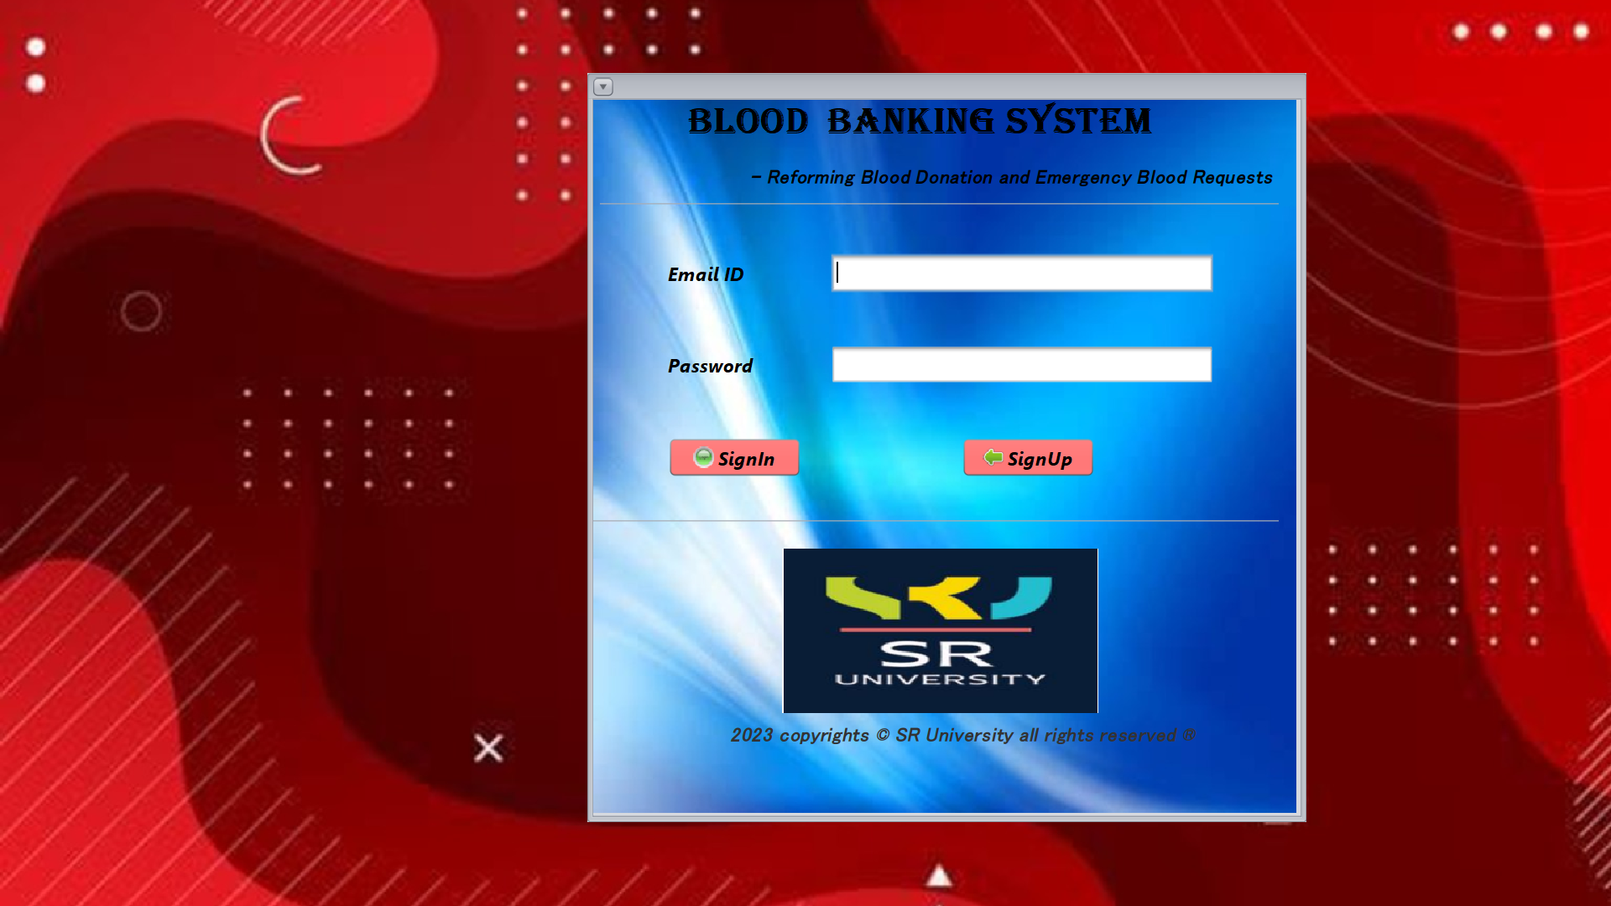
Login Page

Slide 23
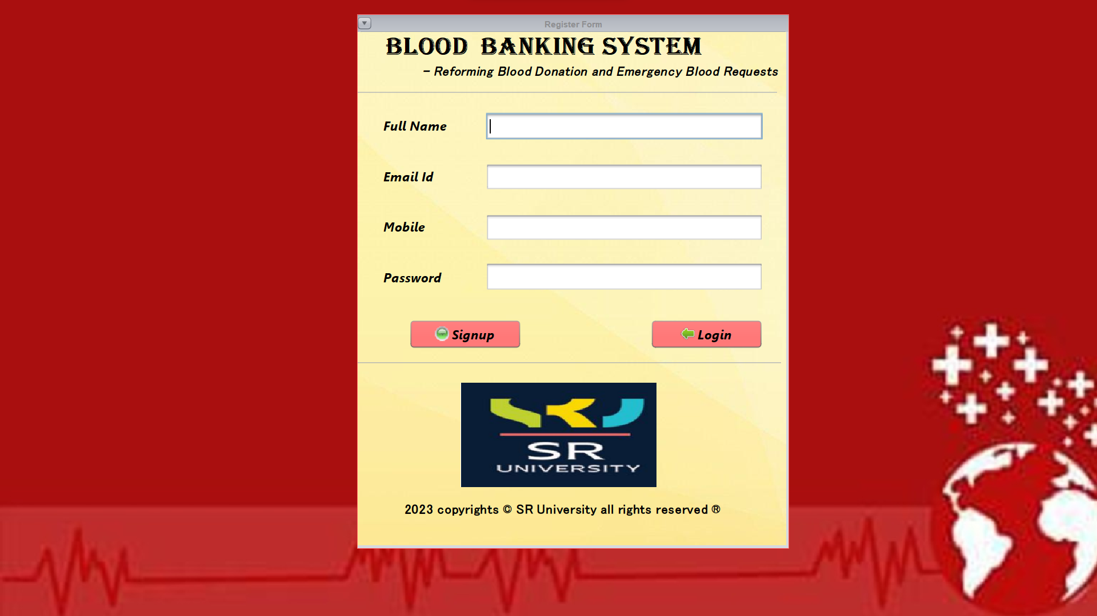
Register Page

Slide 24
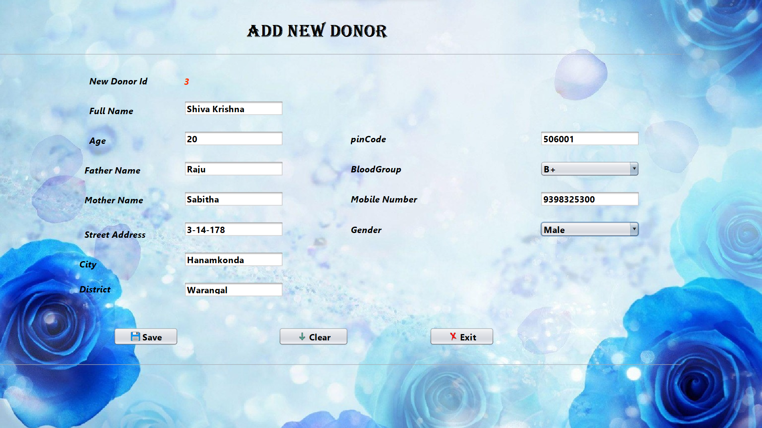
Add Donor Page

Slide 25
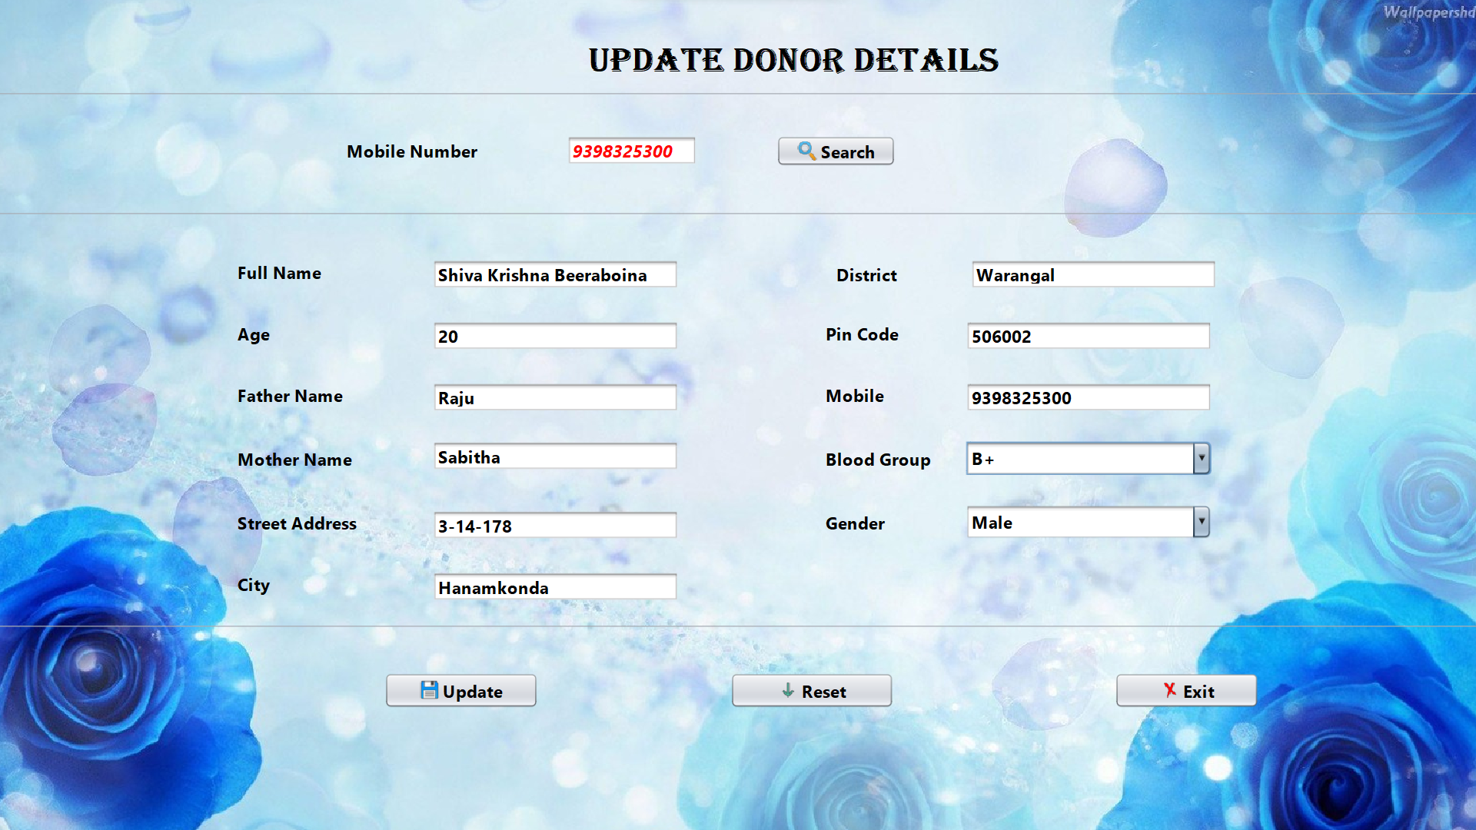
Update Donor Details Page

Slide 26
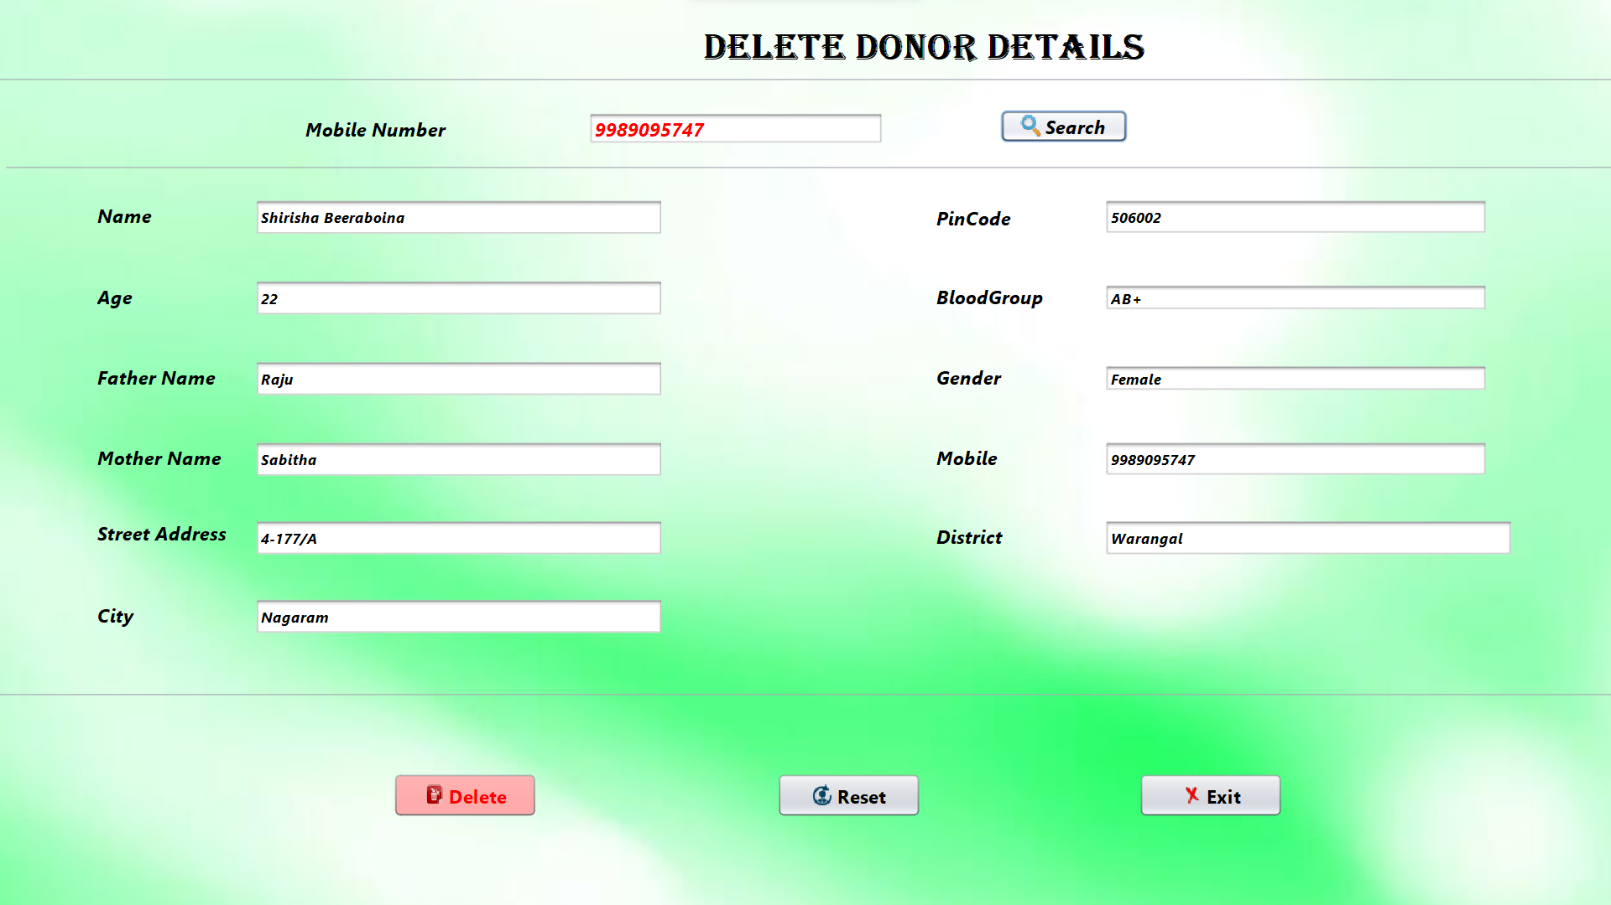
Delete Donor Page

Slide 27
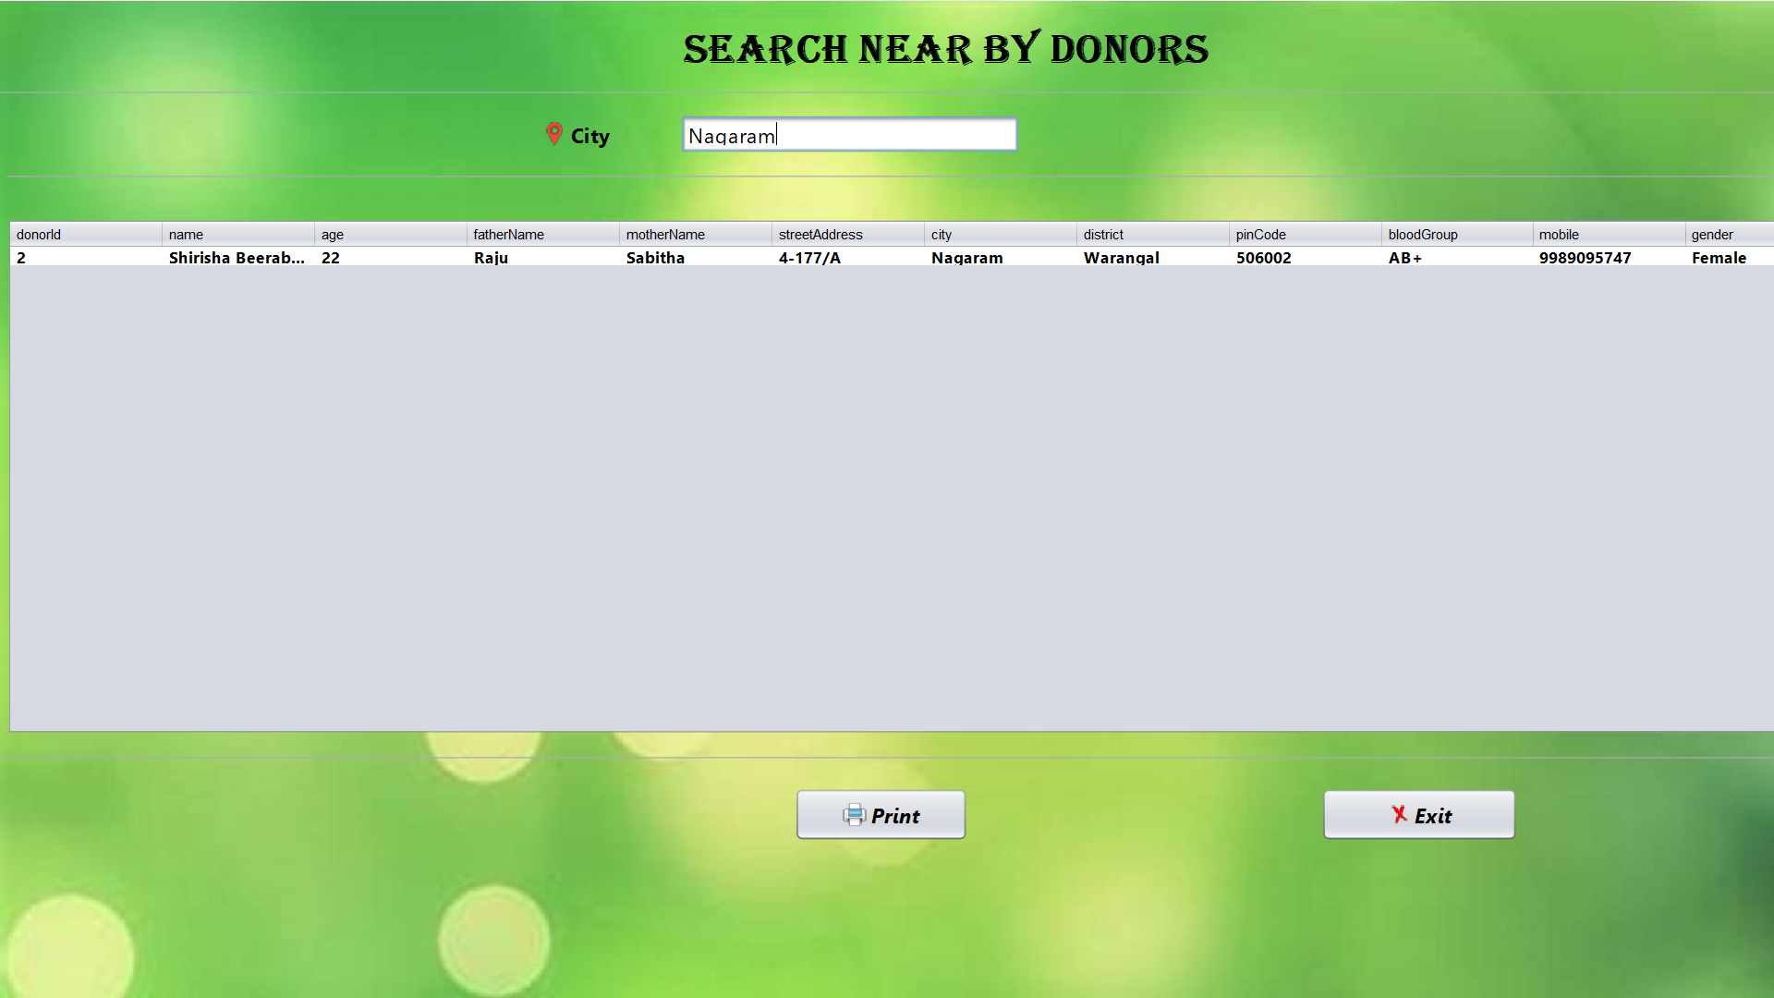
Search by Location Page

Slide 28
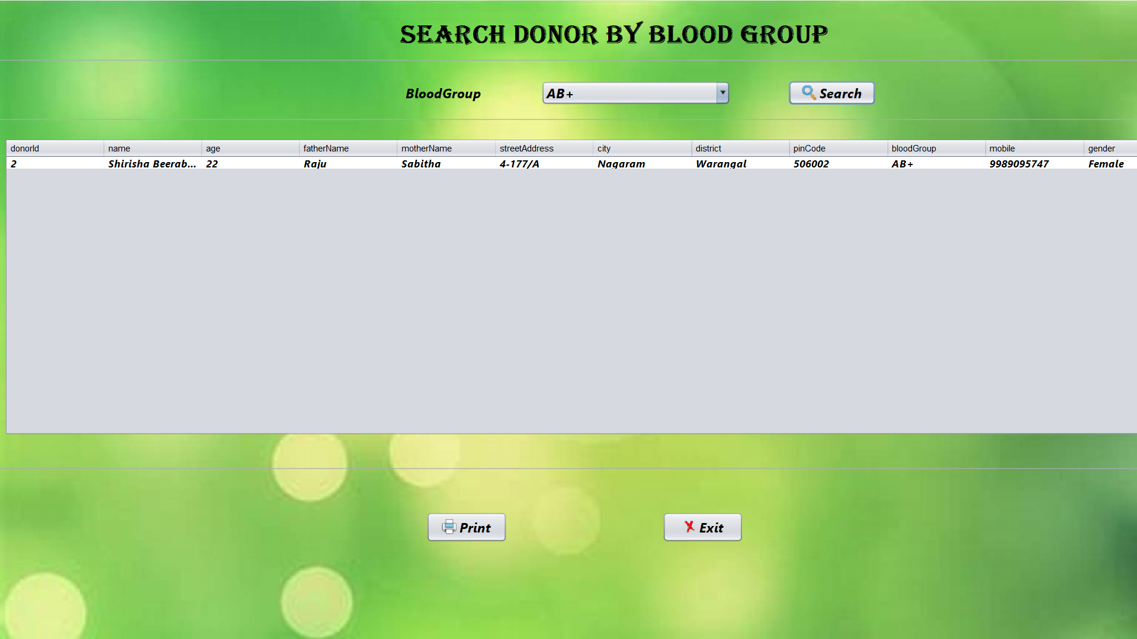
Search by Blood Group Page

Slide 29
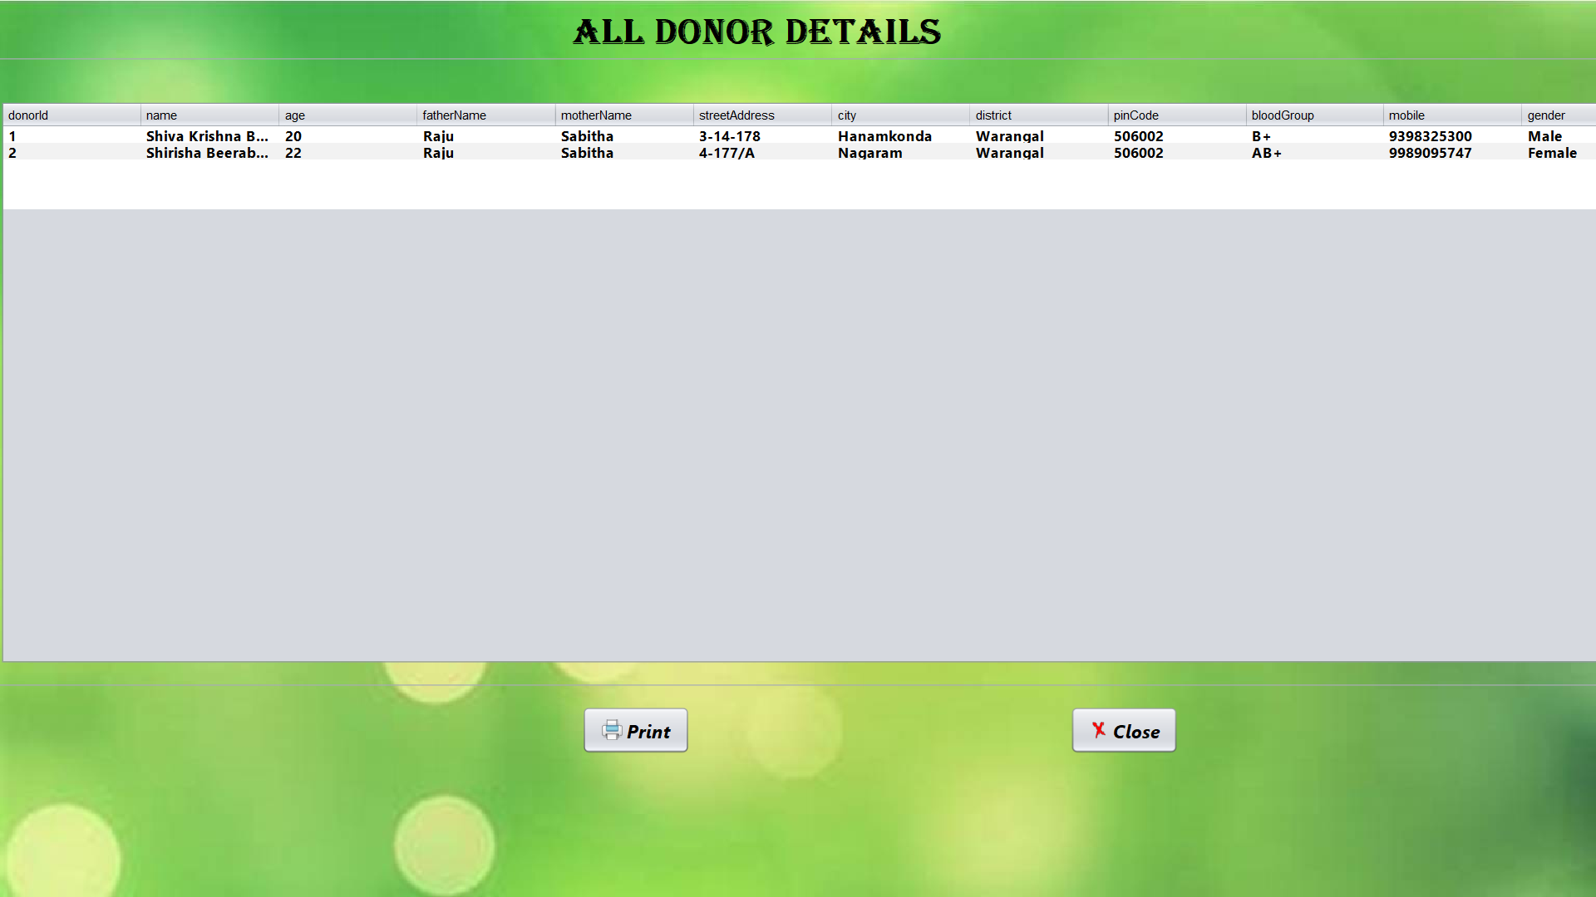
List All Donors Page

Slide 30
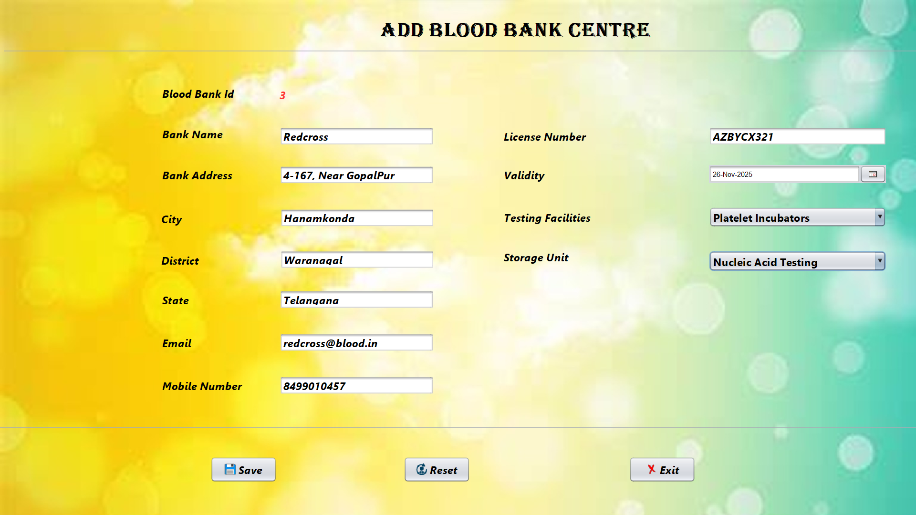
Add Blood Bank Page

Slide 31
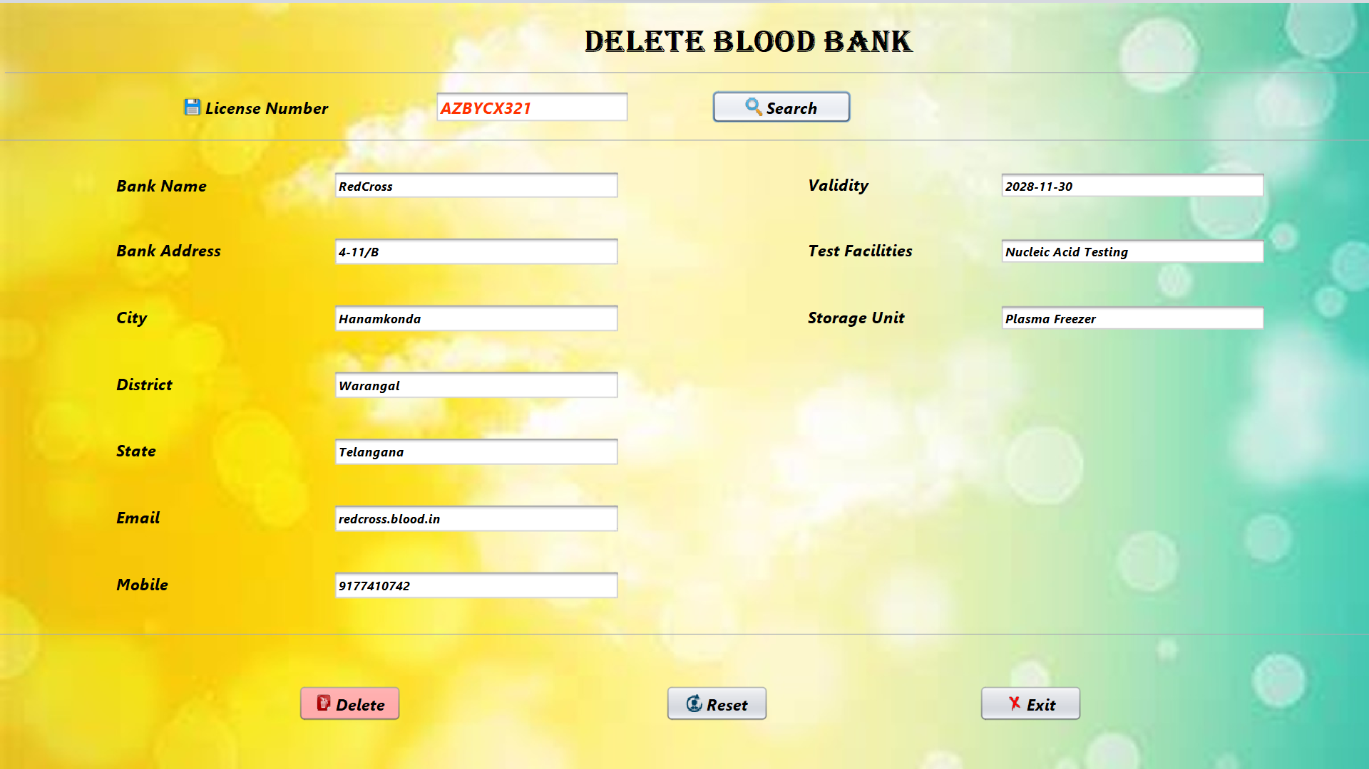
Delete Blood Bank Page

Slide 32
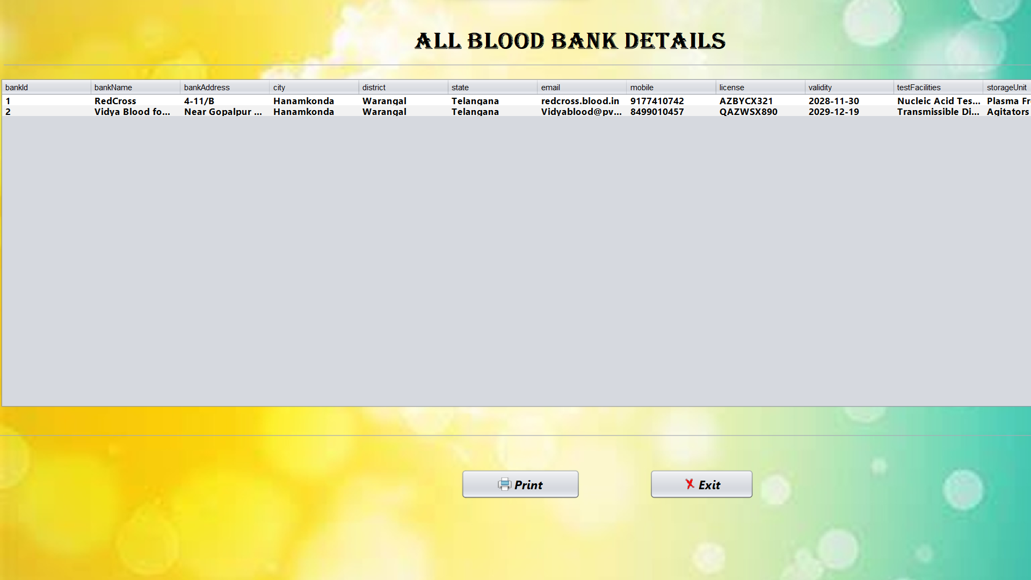
All Blood Banks Page

Slide 33

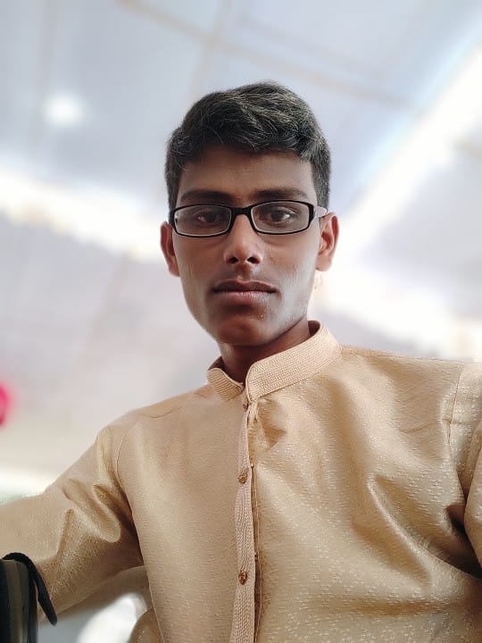
OUR TEAM
Bhuvan Sai
Shiva Krishna

Slide 34
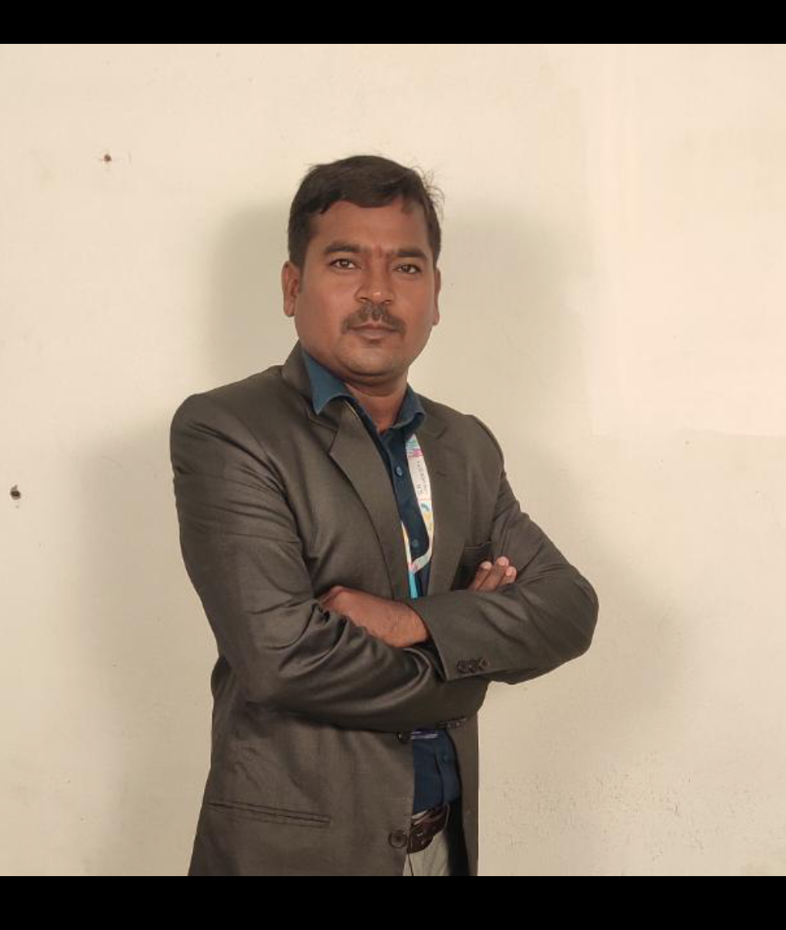
MENTOR
MAHENDER NAGURLA

Slide 35
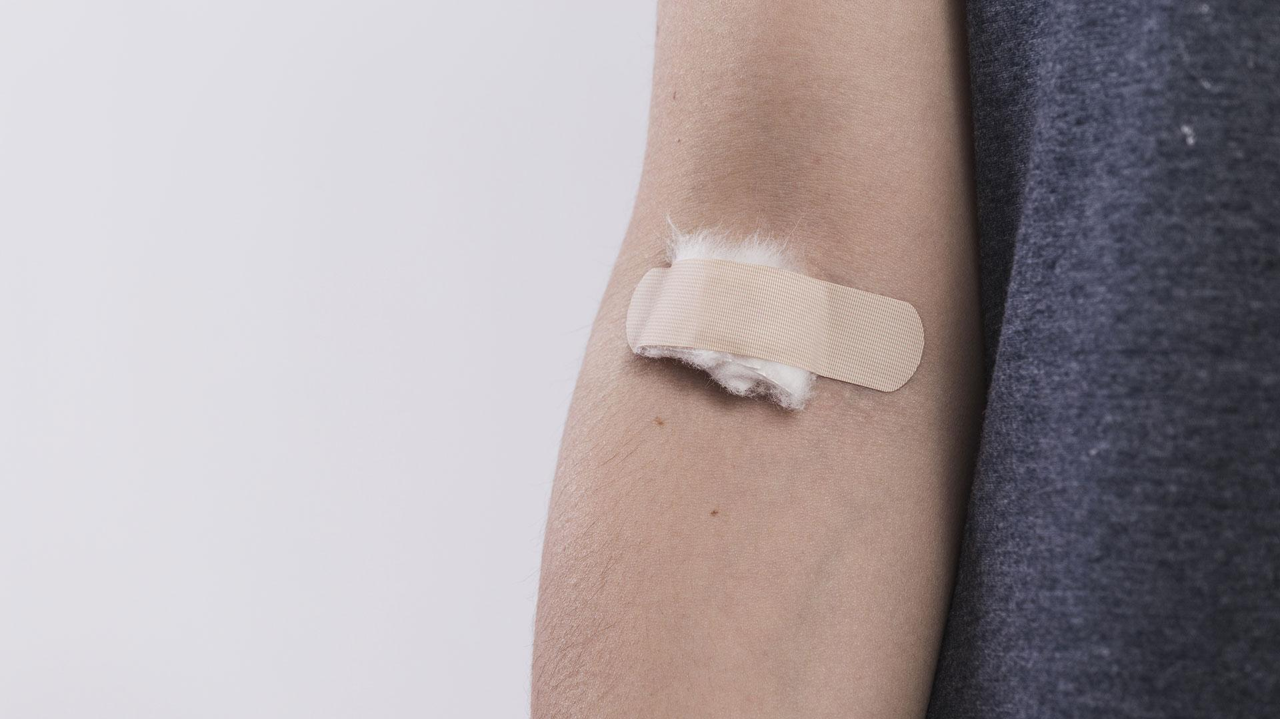


“Donate your blood for a reason, let the reason to be for life.”

Slide 36
THANKS!

